Slide 1
Word Ladders
(part 2)
Problem Reduction

Slide 2
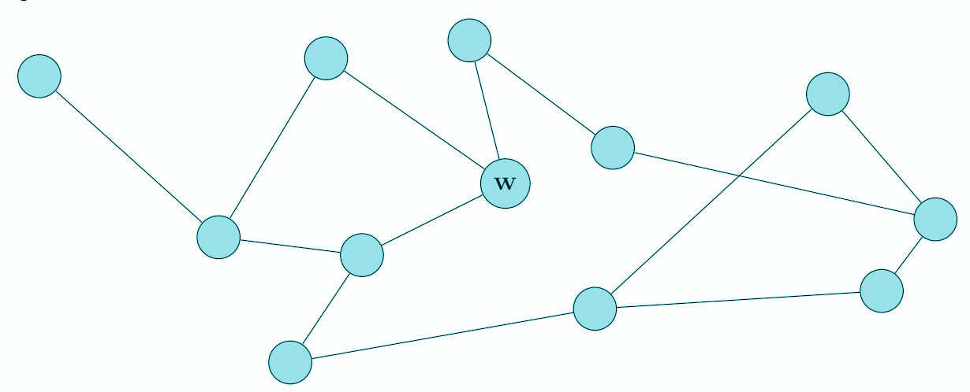
BFS Warm-Up: Wilma’s Secret
Wilma has a secret.
On day 1: Wilma tells the secret to all her friends.
On the following days: all people who heard the secret on the day before will tell the secret to any of their friends who do not know it.
Wilma’s network of friends is shown here. The dots are people and a line means that two people are friends.
How many days does it take before everyone knows the secret? (Include day 1 in your count.)

Slide 3
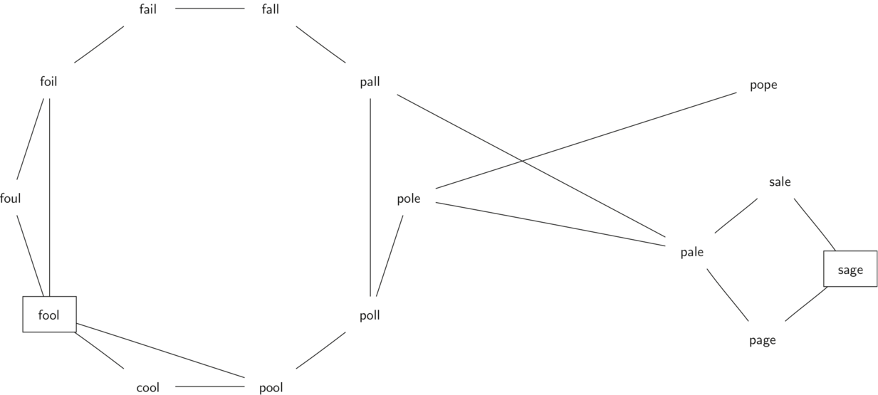
small_dictionary={
"foul":{"fool", "foil"},
"fool":{"foul", "foil", "cool", "pool"},
"cool":{"fool", "pool"},
"pool":{"fool", "poll"},
"poll":{"pool", "pall", "pole"},
"pole":{"poll", "pale", "pope"},
"pope":{"pole"},
"pale":{"pole","pall","page","sale"},
"sale":{"pale","sage"},
"sage":{"sale","page"},
"page":{"pale", "sage"},
"pall":{"poll", "pale", "fall"},
"fall":{"fail","pall"},
"fail":{"fall","foil"},
"foil":{"foul", "fail"}
}
Use VSCode breakpoints to step through the BFS_path algorithm.
In particular, pay attention to the contents of :
path_queue
old_path
last_node
new_path
Graph.py - BFS on a word relationship graph

Slide 4
Word Ladders
Come up with word ladders for:
RUG -> CAT
HEAD -> TAIL

Slide 5
Word Ladders: Not The Best Solution
RUG
BUG BAG
BAT
CAT
This solution has 3 rungs.

Slide 6
Word Ladders: The Best Solution
RUG -> RAG -> RAT -> CAT
RUG -> RUT -> CUT -> CAT
RUG -> RUT -> RAT -> CAT
The shortest solution(s) have 2 rungs.
Notes:
What makes this solution better than the solution on the previous slide?
Fewer words…

Slide 7
Word Ladders: One Solution
HEAD -> HEAL -> TEAL -> TELL -> TALL -> TAIL
HEAD -> HEAR -> HEIR -> HAIR -> HAIL -> TAIL
The shortest solutions have 4 rungs.

Slide 8
What are some unique questions that we might want to answer with the word ladder problem?
Notes:
Getting to the model can take a lot of time…

Slide 9
Exercises:
Graph
adj_list: dict[str, st[str]] vertices: set[str] edges: set[tuple[str]]]
__init__(adj_list: dict[str, list[str]]) is_vertex(str): bool get_neighbors(str): set[str] is_valid_path(list[str]): bool get_shortest_bfs_path(str, str): tuple[str] get_shortest_bfs_path_length(str, str): int get_all_shortest_bfs_paths(str, str): set[tuple[str]]
Extend the Graph class to create a Word Ladder-specific interface for a graph-based solution to the problem.
LadderGraph
__init__(list[str]) hamming_distance(str, str): int build_adj_list(list[str]): dict[str, list[str]] is_valid_word(str): bool is_valid_ladder(list[str]): bool get_rung_length(tuple[str]): int get_shortest_ladder(str, str): tuple[str] get_all_shortest_ladders(str, str): set[tuple[str]] get_all_ladders(str, str, int): set[tuple[str]]
Notes:
Note: building the adjacency list is *slow* O(n^2) so uploading to GradeScope will take a long time. Don’t panic

Slide 10
Python Inheritance
An inheritance relationship is specified in the constructor of the child class: class LadderGraph(Graph):
A child class inherits all the attributes and methods of the parent class
myLadderGraph = LadderGraph(small_dictionary)
print("Vertices:", myLadderGraph.vertices)
print("Edges:", myLadderGraph.edges)
The super() method child can be used to invoke a parent method/attribute in case there is an overriding method definition in the child class:
def __init__(self, word_list:list[str]):
adj_list = self.build_adj_list(word_list)
super().__init__(adj_list)
inheritance_demo.py

Slide 11

What is the time complexity of build_adj_list?
Running GradeScope tests is SLOW.

